Slide 1

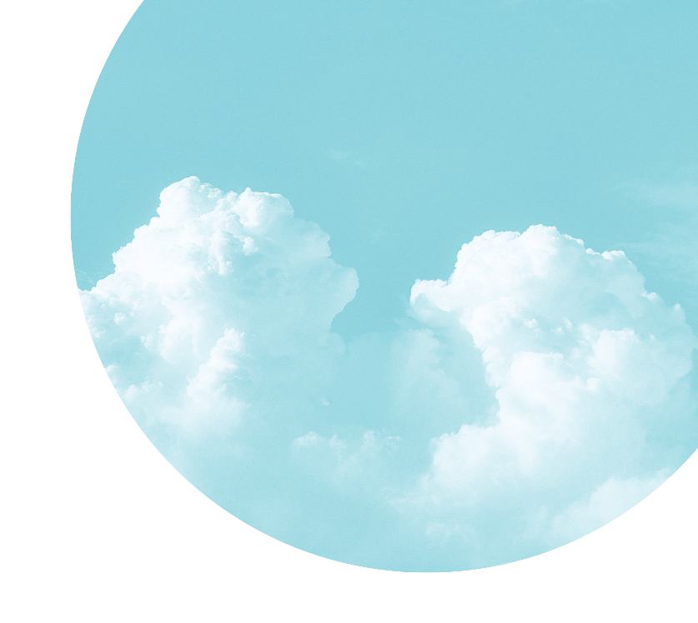

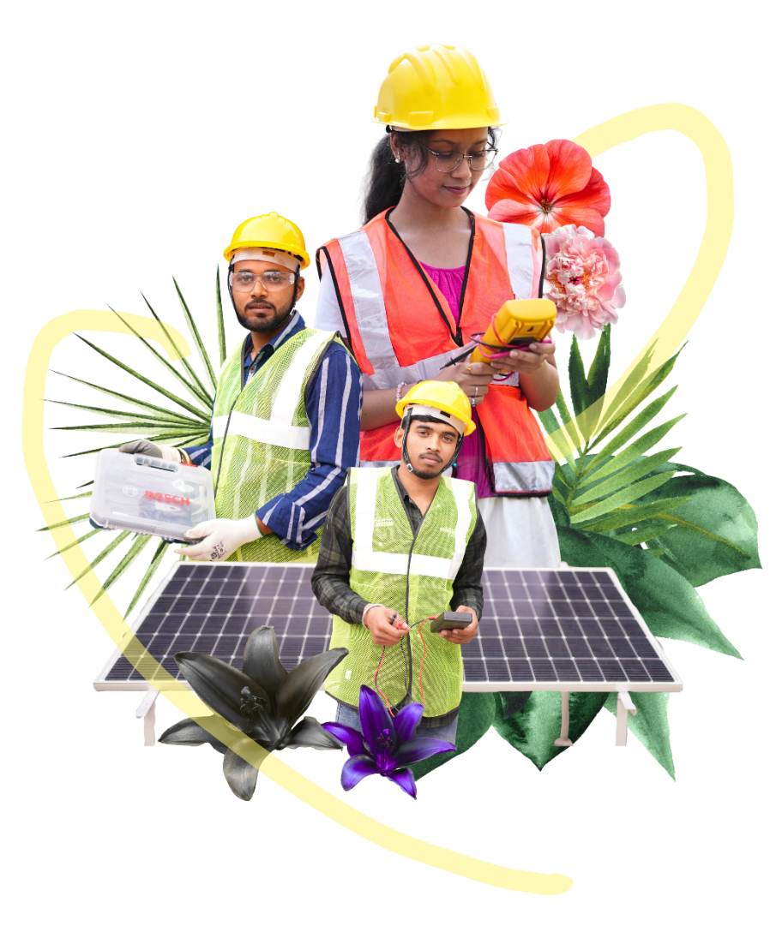
Solar PV Installation and Maintenance
Notes:
VO: Welcome to this course on Solar PV Installation and Maintenance.

Slide 2

Course Navigation
Notes:
VO: Here you will understand the navigation of the course. Hover on each option on the screen to know more.

Slide 3
Notes:
VO: Hello, I am Maya and I will be your guide for this course

Slide 4
Course Introduction
Course Description
This course helps you to learn how to install, connect, test, and maintain a solar PV system.
Duration (Hrs)
Audience
Click each tab to know more.
Notes:
Duration: 2 hrs
Audience: This course is for Technicians and whoever would like to learn how to install the solar PV system.
VO: Welcome to Solar PV Installation and Maintenance course. In this course, you will learn how a solar system is installed and made ready for use. You will see each step, understand why it is done, and learn how to perform it correctly on-site.

Slide 5
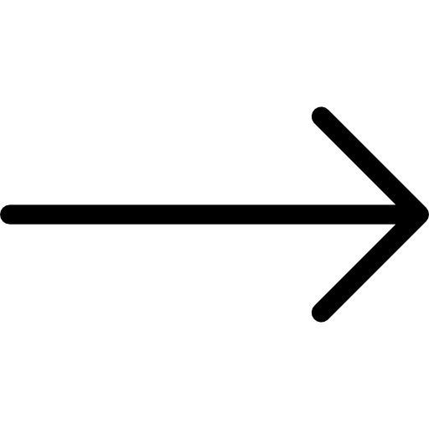
Course Objective
By the end of this course, you will be able to:
Identify the main steps and components of solar PV installation
Understand how systems are installed and connected
Apply correct methods for wiring, setup, and testing
Follow safe practices and perform basic system checks

Slide 6
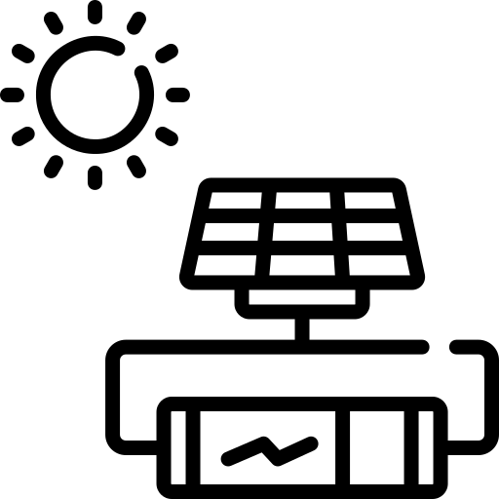
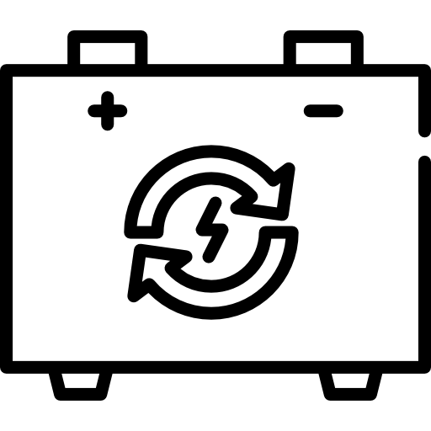
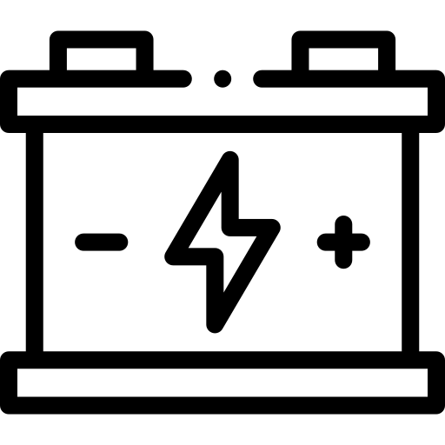
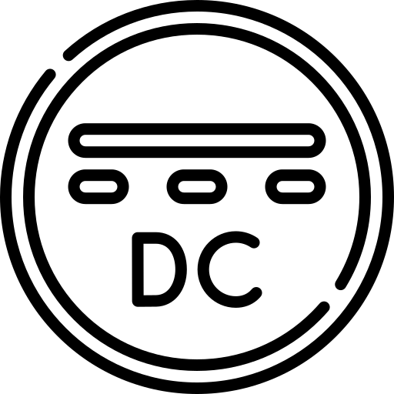
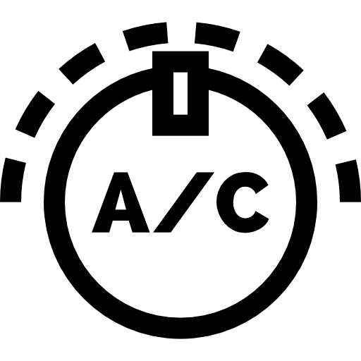
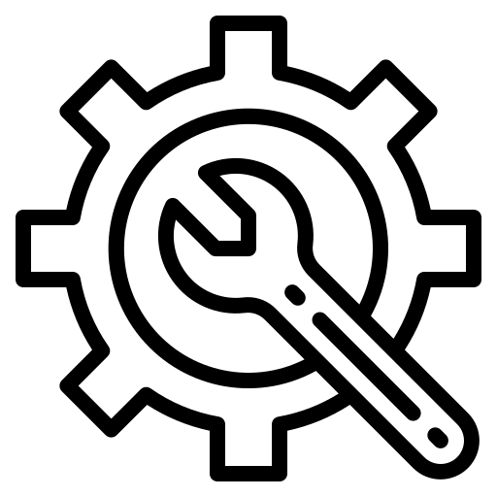
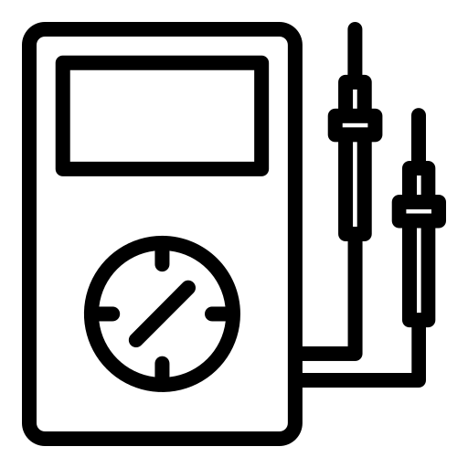
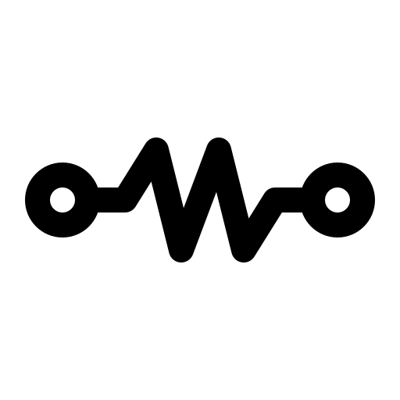
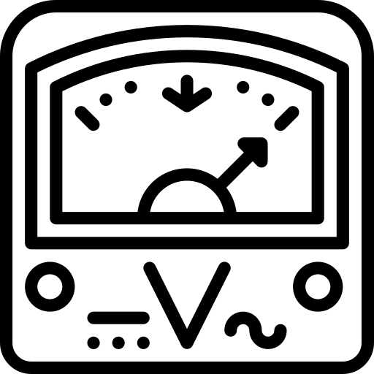
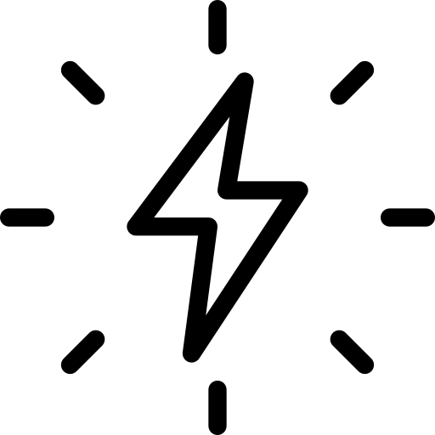
Key Terms
Mounting Structure
Array
Alignment
Cable Routing
A system that uses sunlight to make electricity.
Changes solar DC into electricity that home
machine.
Stores electricity so it can be used at night or on cloudy days.
DC Cabling
System Integration
AC Wiring
Distribution Board (DB)
Electricity that flows in one direction. Solar panels make DC.
Electricity that flows in one direction. Solar panels make DC.
Electricity used in homes and offices. Fans, lights, and TVs.
Connection Tightening
Continuity Test
Insulation Test
System Start-up
Electricity that flows in one direction. Solar panels make DC.
Electricity that flows in one direction. Solar panels make DC.
Electricity used in homes and offices. Fans, lights, and TVs.
Notes:
VO: Here are the key terms used in the course. Click each term to know more about each of them.

Slide 7
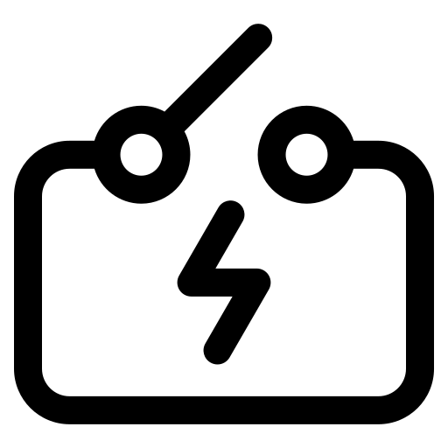
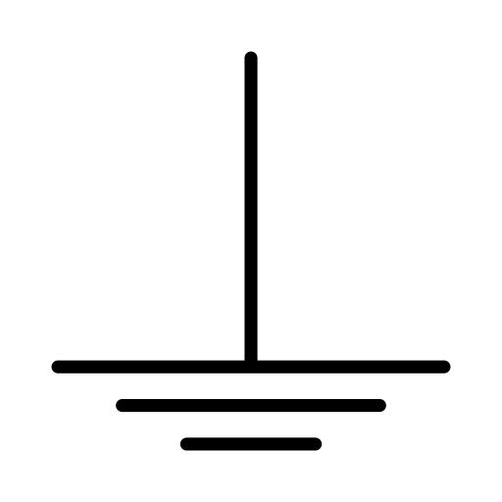


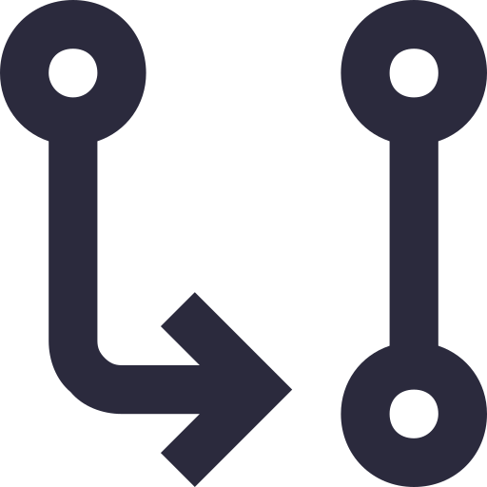

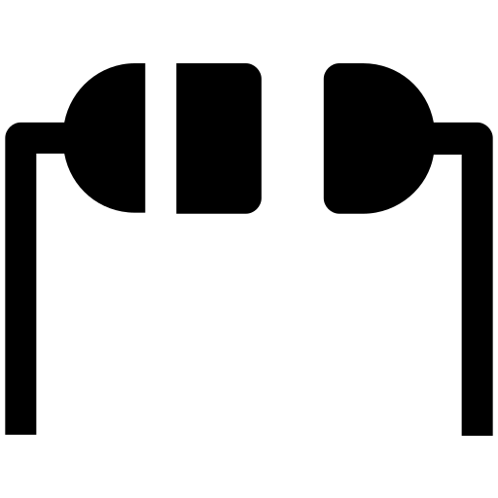
Key Terms
PPE
Routine Maintenance
Preventive Maintenance
Commissioning
Changes solar DC into electricity that home
machine.
Stores electricity so it can be used at night or on cloudy days.
A system that uses sunlight to make electricity.
Inspection
Reporting
Remote Monitoring
System Performance
Electricity that flows in one direction. Solar panels make DC.
Electricity that flows in one direction. Solar panels make DC.
Electricity used in homes and offices. Fans, lights, and TVs.
Notes:
VO: Here are the key terms used in the course. Click each term to know more about each of them.

Slide 8
Installation Process Overview
Video
Structure
Panel
Wiring
Inverter
Testing
Sunlight falls on solar panels
Panels generate DC electricity
Inverter converts DC to AC
AC power runs appliances
Notes:
VO: Before we begin, let’s first understand the overall installation process. A solar system is installed step by step, starting from the structure, then panels, followed by wiring, inverter setup, and finally testing. We will go through each of these steps one by one in this course.

Slide 9
Pre-Installation: Site Survey & Vendor Planning
Video to be embedded
PM Surya Ghar Full Video
0:00 seconds to 00:46 (crop this part)
Check rooftop space, strength, and sunlight exposure
Finalize vendor and system design
Notes:
VO: First, we assess the rooftop to check space, strength, and sunlight exposure. Then, based on this, we finalize the vendor and system design for the site.

Slide 10
Mounting Structure Installation
Video to be embedded
PM Surya Ghar Full Video
0:46 seconds to 10:00
Base of the solar system
Supports and holds panels in place
Notes:
VO: Let’s start with the mounting structure, which acts like the foundation of the system. Just like a weak foundation can affect a building, if the structure is not fixed properly, the panels may become loose or misaligned. Now watch how the mounting structure is installed step by step. Notice how proper alignment and fixing ensure a strong and stable base.

Slide 11

Check your Understanding
A technician installs the mounting structure without checking alignment properly. What is the most likely long-term issue?
A. Faster power generation
B. Panels may become loose or misaligned
C. Increased battery backup
D. Improved inverter efficiency
Correct Answer: B

Slide 12
Check your Understanding
Why is the mounting structure compared to the foundation of a building?
A. It stores electricity
B. It powers the inverter
C. It supports and stabilizes the entire system
D. It converts DC to AC
Correct Answer: C

Slide 13
Mounting Structure Activity
Activity: “Build the Base”
Materials needed for students:
Wooden sticks / cardboard strips
Nuts-bolts (or paper fasteners)
Uneven surface (book/tilt board)
Activity Steps:
Ask groups to build a small structure
Give them 2 conditions:
  One group builds properly
  One group builds quickly (no alignment focus)
Apply slight pressure or tilt
Discussion:
Which structure was stable?
What went wrong?
Learning:
Alignment matters
Tightening matters
Foundation analogy becomes real

Slide 14
Panel Placement: Direction & Tilt Optimization
Video to be embedded
PM Surya Ghar Full Video
10:00 seconds to 12:30
Set correct direction and tilt using compass and inclinometer
Lift and position panels securely on the structure
Notes:
VO: Now watch how the panel direction and tilt are set using simple tools. Also observe how the panels are lifted and positioned properly on the structure.

Slide 15
Check your Understanding
A technician installs panels facing the wrong direction but with correct tilt. What is the most likely result?
Maximum energy generation
Reduced system efficiency
Better inverter output
No impact on performance
Correct Answer: B

Slide 16
Check your Understanding
Which tool is commonly used to check proper panel tilt during installation?
A. Clamp meter
B. Inclinometer
C. Tester
D. Wire stripper
Correct Answer: B

Slide 17
Electrical Installation & System Integration
Perform DC and AC wiring between system components
Install inverter and complete system connections
Video to be embedded
PM Surya Ghar Full Video
12:30 seconds to 14:55
Notes:
VO: Now observe how electrical connections are made between components. Also watch how the inverter is installed and integrated into the system.

Slide 18
Check your Understanding
During installation, DC and AC wiring are mixed incorrectly. What is the greatest risk?
A. Reduced sunlight
B. System imbalance or equipment damage
C. Extra battery charging
D. Improved output voltage
Correct Answer: B

Slide 19
Check your Understanding
A solar system worked properly for two days and then suddenly stopped. Panels are clean and inverter is functioning correctly. What is the most likely issue?
A. Incorrect panel tilt
B. Loose cable connection
C. Excess sunlight
D. Overcharged battery
Correct Answer: B

Slide 20
Activity: “Failure Investigation”
Scenario: System worked for 2 days, then stopped.
Data given:
Loose cable
Proper inverter
Clean panels
Task:
Identify most likely cause + explain
Learning:
Diagnostic thinking
Real technician skill
Mandavi – How do we plan to do this activity. Also, the answer is already given in the previous CYU.

Slide 21
Best Practices of Wiring and Distribution board
Video to be embedded
https://youtu.be/jQ5WB7-ftIs to be merged at 0:42 to 6:20 with https://youtu.be/1hcKMxpyzUw at 1: 02 to 10:15
Connect system to distribution board
Ensure safe and organized wiring
Notes:
Now we connect the system to the distribution board, which sends electricity to different appliances. Observe how the system is connected to the distribution board.
Notice how wiring is arranged neatly and safely.
You can think of it like a main switchboard in a house, where power is safely distributed to fans, lights, and other devices.

Slide 22
System Inspection & Approval
Video to be embedded
PM Surya Ghar Full Video
14:55 seconds to 22:18
Inspect installation for safety and compliance
Verify system before approval and operation
Notes:
VO: Now watch how the system is inspected after installation. Observe the checks done to ensure safety and compliance before approval.

Slide 23
Check your Understanding
Before approving a newly installed solar system, officials mainly inspect for:
A. Decorative appearance
B. Safety and compliance
C. Mobile network signal
D. Weather forecast
Correct Answer: B

Slide 24
Activity: Connection Check Challenge
Objective: Students identify and fix connection issues
Setup: Use:
  2 wires (or ropes)
  2 labels: “Battery +” and “Battery –”
  1 “Inverter” label
Create 2 setups in front of class:
  One correct
  One with loose / wrong connection
Step 1: Divide class into groups
Each group sends 1 “technician”
Step 2: Task
Technician must: Inspect setup and decide:
Safe / Unsafe
Fix it physically
Step 3: Time pressure
Give 30-45 seconds per student
Step 4: Class votes
Was it correct?
What mistake was there?
Ask:
What was wrong?
What could happen if not fixed?
Learning Outcome
Recognize loose/wrong connections
Take action, not just explain
Understand real-site urgency
Builds confidence

Slide 25
Earthing & Safety Testing
Video to be embedded
PM Surya Ghar Full Video
22:18 seconds to 23:12
Test earthing for proper grounding and safety
Ensure system protection against faults and lightning
Notes:
VO: Now observe how earthing is tested for safety. Notice how proper grounding is ensured to protect the system.

Slide 26
Check your Understanding
What is the primary purpose of earthing in a solar PV system?
A. Increase panel voltage
B. Store backup electricity
C. Provide safe path for fault current
D. Improve battery appearance
Correct Answer: C

Slide 27
Activity: System Breakdown Simulation
Setup: Give system diagram
Task:
Instructor removes one connection
Students: Predict:
What stops working?
Why?
Learning:
System dependency
Critical thinking

Slide 28
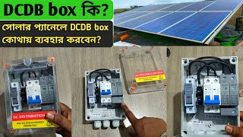
System Testing - bengali
– to convert to english
Notes:
VO: Just like checking a vehicle before driving, testing helps us make sure everything is working correctly and safely. Watch how tests are performed to check if current can flow properly and if there are any faults in the system. Observe how the system is tested before start-up. Notice how checks are done to ensure safe operation.

Slide 29
Check your Understanding
A technician skips system testing because all connections “look fine.” What is the biggest risk?
A. Faster commissioning
B. Hidden faults may go undetected
C. Improved grid synchronization
D. Better inverter cooling
Correct Answer: B

Slide 30
Activity: Test or Trouble?
Setup
Write 3 situations on board/cards:
“All connections look fine”
“System just installed”
“Customer wants quick start
Steps
Divide class into groups
Each group must decide:
“Start system OR Test first?”
They must:
Stand on one side of room (Start / Test)
Explain why
Twist
Instructor says:
“System fails after start — now what?”
Learning
Testing is not optional
Builds decision confidence

Slide 31
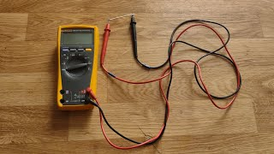
SYSTEM START-UP – Hindi
– to convert to english
Notes:
VO: Now observe the correct sequence of starting the system.

Slide 32
Check your Understanding
Why is the correct start-up sequence important during commissioning?
A. Improves panel cleaning
B. Prevents electrical faults and operational issues
C. Increases structure strength
D. Reduces sunlight dependency
Correct Answer: B

Slide 33
Activity: Live Sequence Build
Setup: Write steps on paper cards:
Check connections
Switch ON inverter
Start system
Observe output
Steps:
Give cards to different students
Ask them to:
Arrange themselves in correct order
Class can:
Agree / disagree
Rearrange physically
Learning
Sequence memory + logic
Movement = engagement

Slide 34
Net Metering & System Commissioning
Video to be embedded
PM Surya Ghar Full Video
23:12 seconds to 27:55
Check net meter and grid connection setup
Energize system for electricity generation
Notes:
VO: Now watch how the net meter is checked and connected to the grid. Observe how the system is energized to begin power generation.

Slide 35
Check your Understanding
What is the role of net metering in an on-grid solar system?
A. Measures rainfall
B. Tracks battery water level
C. Monitors electricity exchanged with the grid
D. Controls panel tilt
Correct Answer: C

Slide 36
System Handover & Documentation
Video to be embedded
PM Surya Ghar Full Video
27:55 seconds to end
Complete handover between consumer and DISCOM
Finalize documentation and approvals
Notes:
VO: Finally, observe how the system is handed over after completion. Notice how documentation and approvals are completed at this stage.

Slide 37
Activity: Risk Ranking
Show 4 issues:
Loose wire
Overloaded DB
Proper earthing
Neat wiring
Task:
Rank from MOST dangerous → least
Learning:
Prioritization
Safety judgement

Slide 38
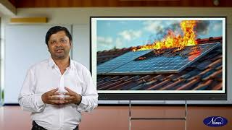
Basic Safety Practices in Solar PV work
Start at 1:20 seconds
– to improve to english
Notes:
VO: Safety comes first during any installation work. Pay attention to the correct use of PPE and safe working practices on-site.

Slide 39
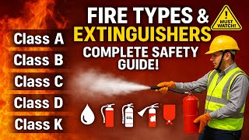
Administering First Aid and Fire Safety Protocol
Download and minise the size.
Notes:
VO: In case of emergencies, basic first aid and fire safety knowledge is essential. Understand how to respond quickly and handle such situations safely.

Slide 40
Activity: Safety Inspector
Setup: Create a “fake work area”:
One student without PPE
One loose wire
One unsafe posture
Steps
One student becomes:
“Safety Inspector”
They must:
Walk around
Stop work
Identify issues
Others:
Defend their actions
Learning
Real-world safety enforcement
Builds confidence to intervene
Notes:
Let’s apply what we’ve learned. Identify safety issues in the setup and take action like a real site inspector.

Slide 41
Preventive Maintenance and Reporting
Video to be embedded
https://youtu.be/bw8HreOKFmk (crop 00:20 to 02:09 seconds and merge with the video below in the beginning
https://youtu.be/pQAZQOgx9SA
00:42 seconds 07:10
Observe cleaning and inspection steps
Notice regular maintenance practices
Notes:
After installation, the system needs regular care. Just like a bike needs cleaning and servicing, solar panels also need maintenance to work efficiently. Observe how cleaning and inspection help maintain system performance.

Slide 42
Check your Understanding
A solar system output drops significantly after three months. Panels are dusty and bird droppings are visible. What is the most likely reason?
A. Wrong inverter size
B. Poor preventive maintenance
C. Excess grid voltage
D. Incorrect earthing type
Correct Answer: B

Slide 43
Activity: Performance Drop Case
Scenario: Output reduced after 3 months
Groups list:
Possible causes
Most likely cause
Learning: Develop Root cause thinking

Slide 44
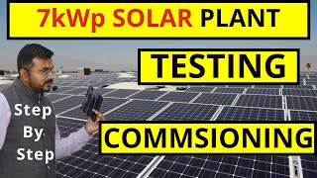
Remote monitoring system
- Download hindi version
– to convert to english
End at 6:45 seconds
Notes:
Remote monitoring helps track how the system is performing. It’s like checking your mobile battery or data usage. You can see if everything is working properly or if there is a problem.
Just like a bike needs cleaning and servicing, solar panels also need maintenance to work efficiently.

Slide 45
Course Summary
In this course:
You understood the complete solar PV installation process
You saw how components are connected and the system works
You learned how installation, wiring, and testing are done
You understood the importance of safety and maintenance
Notes:
VO: In this course, you have understood the complete process of installing a solar PV system.
You saw how different components are connected, how the system is tested, and how it is safely operated and maintained. This knowledge will help you work more confidently on real installation sites

Slide 46
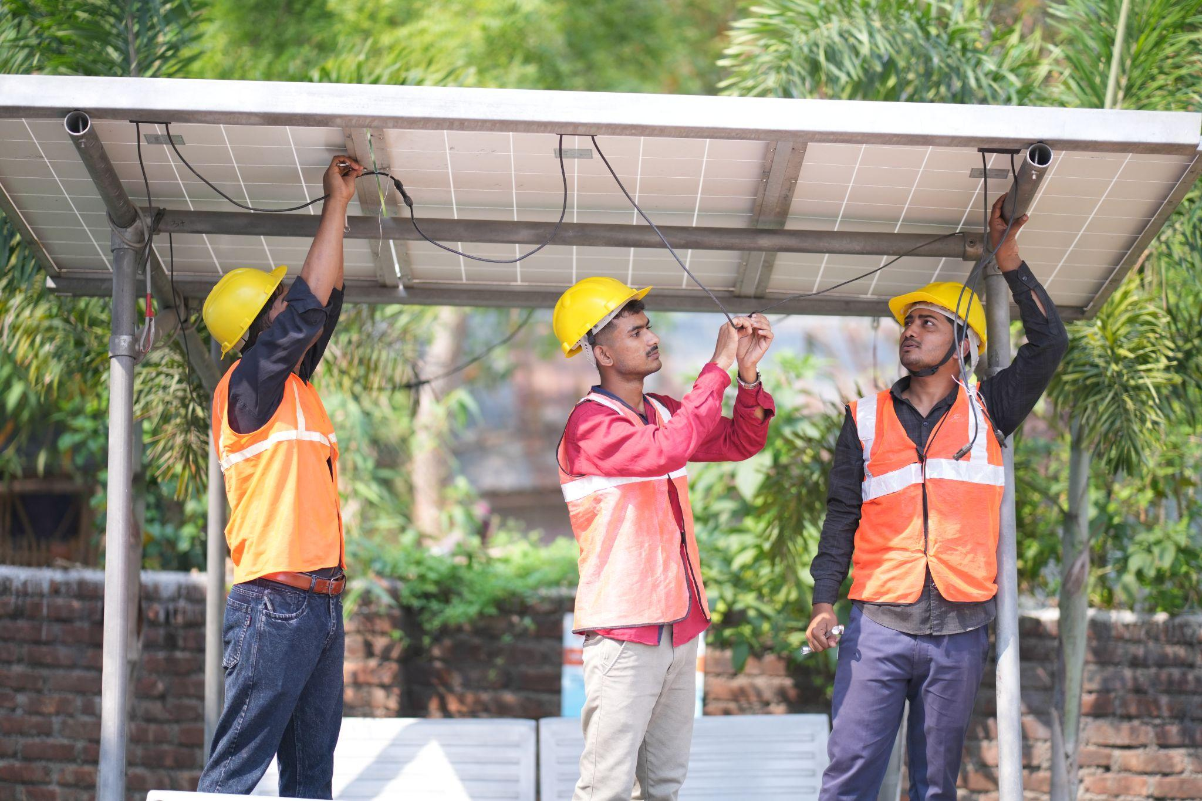
Assessment

Slide 47
Assessment
During rooftop inspection, a technician notices cracks in the mounting foundation. What should be done first?
A. Start panel installation
B. Ignore minor cracks
C. Repair and secure the structure before installation
D. Increase inverter capacity
Correct Answer: C
Notes:
Correct Answer: C. Solar Energy

Slide 48
Assessment
2. Even a loose cable connection can stop an entire solar system from functioning properly.
True
False
Notes:
Correct Answer: C. Solar Energy

Slide 49
Assessment
Column A Column B
1. Earthing A. Safe distribution of power
2. Distribution Board B. Detects insulation leakage
3. Inverter C. Safe path for fault current
4. Insulation Test D. Converts DC to AC
Correct Match:
1 → C
2 → A
3 → D
4 → B
Notes:
Correct Answer: C. Solar Energy

Slide 50
Assessment
4. A system passes visual inspection but fails during testing. What does this indicate?
A. Testing is unnecessary
B. Hidden electrical issues may still exist
C. Panels are oversized
D. Earthing increases voltage
Correct Answer: B
Notes:
Correct Answer: C. Solar Energy

Slide 51
Assessment
5. Which of the following are important during panel placement?
A. Correct tilt angle
B. Proper direction
C. Loose mounting clamps
D. Secure handling during lifting
Correct Answers: A, B, D
Notes:
Correct Answer: C. Solar Energy

Slide 52
Assessment
6. A __________ test checks whether electrical current can safely flow through a circuit.
Answer: Continuity
Notes:
Correct Answer: C. Solar Energy

Slide 53
Assessment
7. Net metering allows excess electricity generated by a solar system to be supplied to the grid.
Answer: True
Notes:
Correct Answer: C. Solar Energy

Slide 54
Assessment
9. A technician notices frequent inverter trips after installation. Wiring appears disorganized and multiple cables are tightly bent. What is the most likely issue?
A. Excess sunlight
B. Improper cable routing and connections
C. High panel efficiency
D. Proper earthing
Correct Answer: B
Notes:
Correct Answer: C. Solar Energy

Slide 55
Assessment
10. Which activities are part of preventive maintenance?
A. Cleaning panels
B. Inspecting connections
C. Ignoring minor faults
D. Monitoring system performance
Correct Answers: A, B, D
Notes:
Correct Answer: C. Solar Energy

